Slide 1
Project : Customer Retention
By R. Rajesh Kannan

Slide 2
Problem: Aim of this project is to analysis the data which get from e-commerce in India to get findings and conclusion. Data is based on customer review based on that review of literature, theories and models have been carried out to propose the models for customer activation and customer retention.

Slide 3
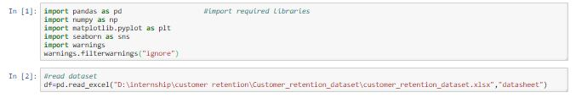
Import Libraries and read the data
Have to import the required libraries that we are going to use.
Have to read the data with pandas library.
Here that xlsx file contains two sheets.

Slide 4
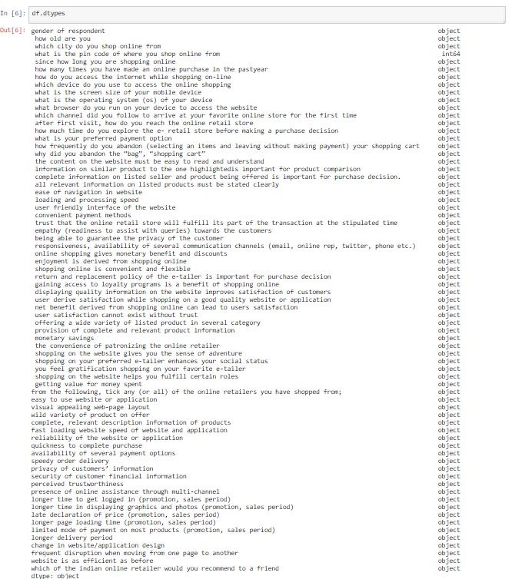

EDA Process: Checking of data type and presence of null values :
Data Type may,
Int
Float
Object
There are no presence Null values.
No skewing in data and presence of outliers due to all data type are categorical.

Slide 5
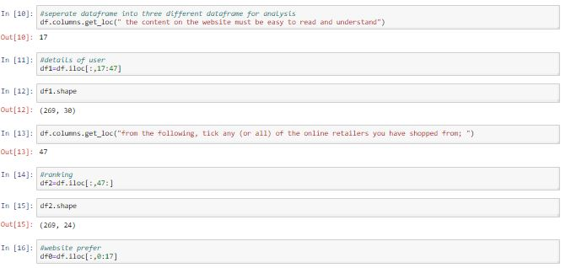
Analysis by Visualization
Here I divide data into three different category (user details, Rating, website prefer).
Based on it we can visualize clearly even in lot of features, and also can find new findings.

Slide 6
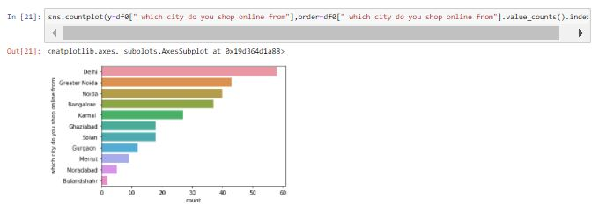
Visualization on user details: Uni variant visualization: Count of city:
Apply countplot in city features to get main cities for online shopping.
Most of the customers are shopping from (Delhi,Greater Noide,Noida,Banglore, karnal).

Slide 7
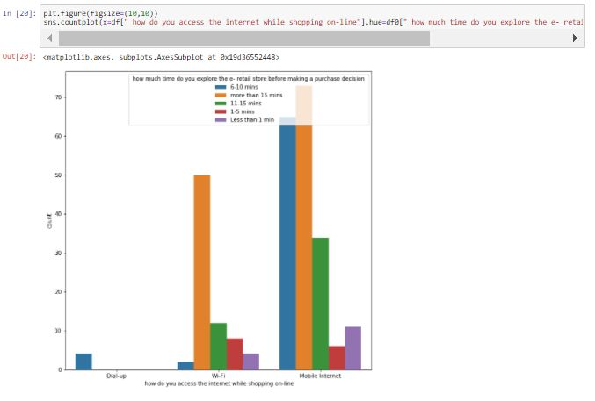
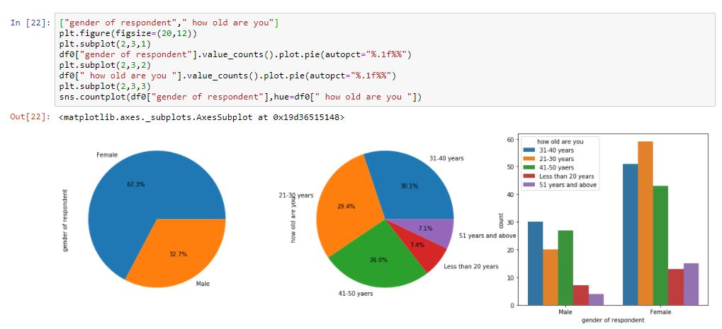
Bi Variant analysis:
Relation between spent time on shopping and internet source.
Customers use mobile internet will spend more time on e-retail.
Relation between gender and age (also uni-variant):
Most of the customers are females nearly about 67%.
Majority of Females are between 31-40, 21-30 and 41-50.

Slide 8
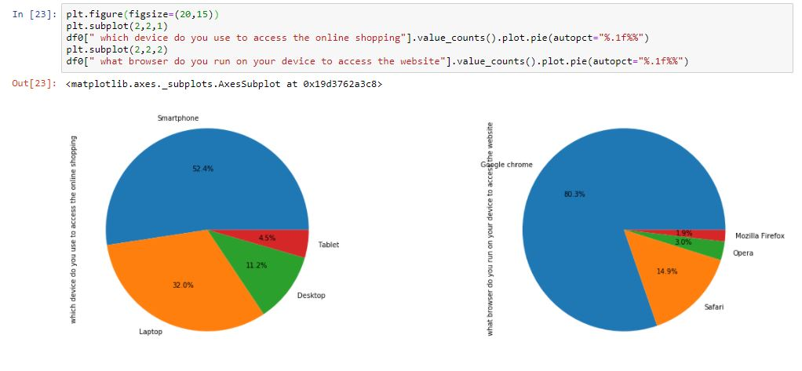
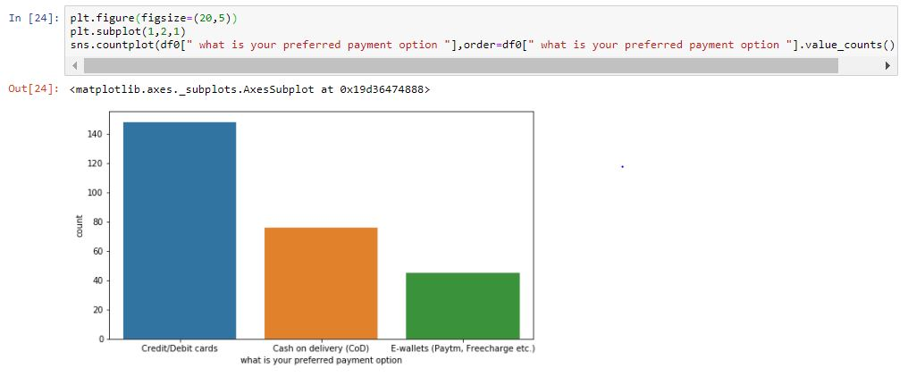
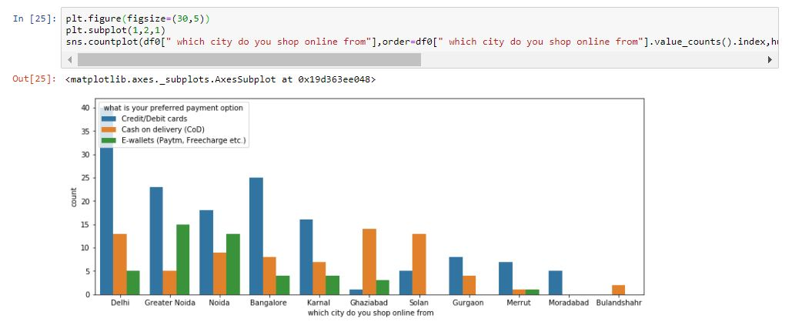
Uni-varient visualization on browser use and device use:
Lot of users are access shopping on smartphone and Laptop.
Mainly users are useing Google chrome as browser to access website.
Uni-varient visualization on Payment option:
Card way transaction are high in payment method than other mode of transaction.
Combine visual of cities and payment method:
Cities like Ghziabad, Solan, cash on delivery payment method plays major roll.
For other cities card payment plays major roll.

Slide 9
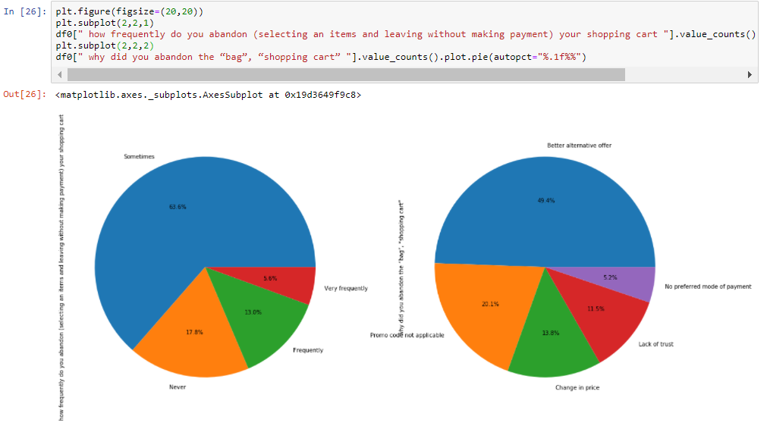
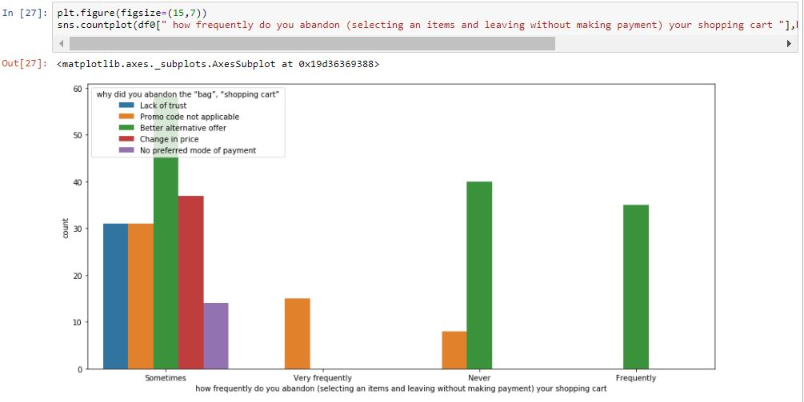
Uni-varient visual on abandon frequency on cart and why:
It shows mostly peoples are abandon cart or bag for better alternative offer.
63% of peoples are abandon shopping cart for sometimes.
Combine visual of abandon frequency on cart and why:

Slide 10
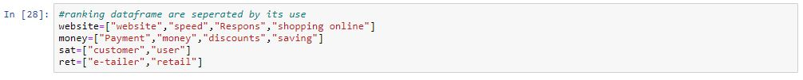
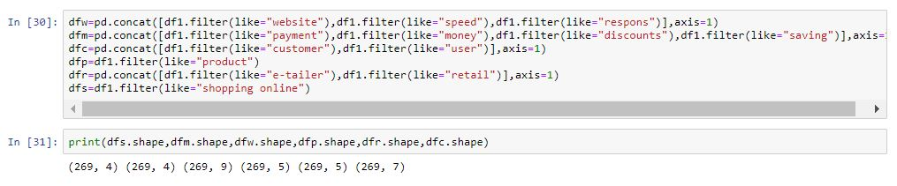
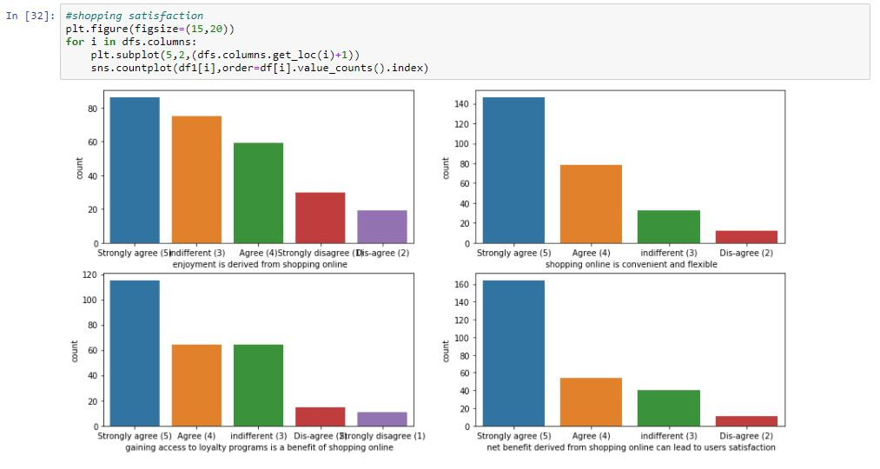
Visualization on Rating data frame:
Divide rating category features as several category for better findings.
Visualize features under shopping satisfaction:
Mostly peoples are strongly agree with shopping benefit, satisfaction, flexible, enjoyment of shopping.

Slide 11
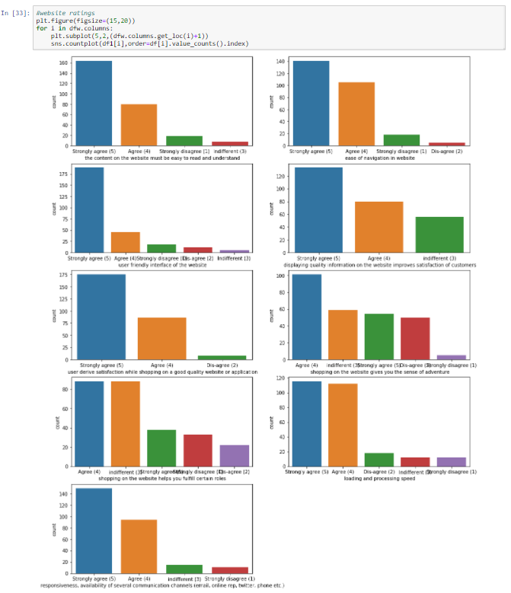
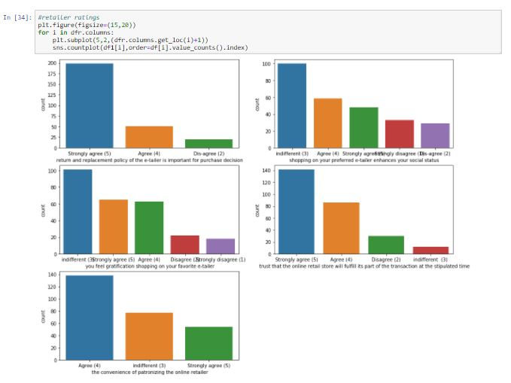
Visualize features under Website Ratings:
Most customers are strongly agree with website speed, response, and website use.
Visualize features under retailer ratings:
Most customers are agree with trust on retailer and replacement policy.
Most customers are rate indifferent for retailer enhances of social status and gratification shopping.

Slide 12
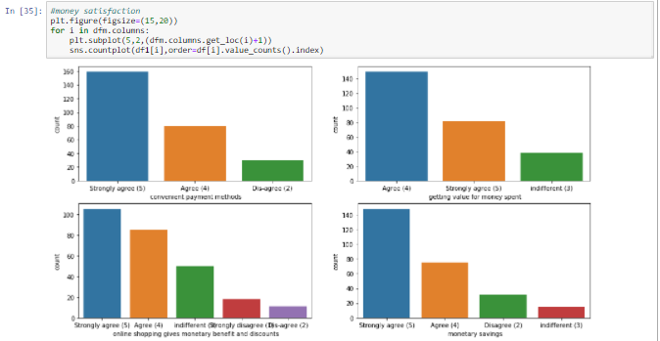
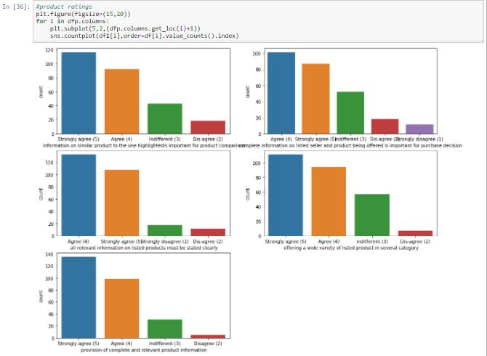
Visualize features under money satisfaction and safety:
Most customers are strongly agree with money satisfaction and trust.
Visualize features under product rating:
Most customers are rated strongly agree with product related features.

Slide 13
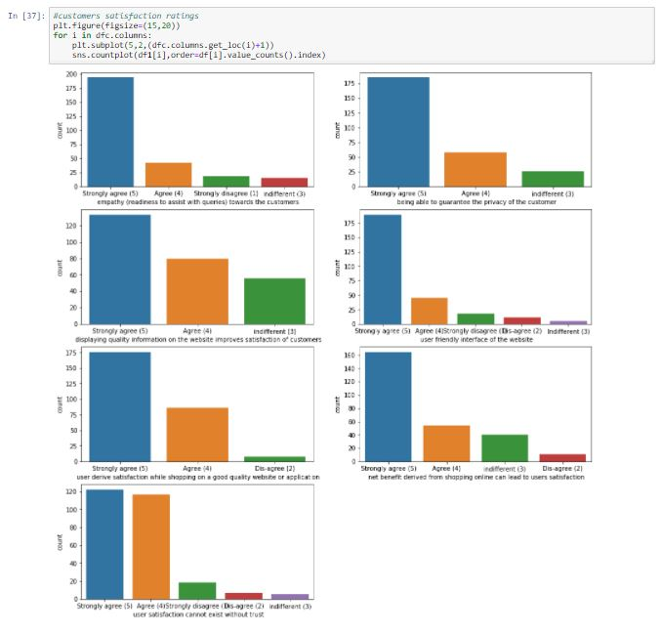
Visualize features under customer satisfaction ratings:
Most customers are strongly agree with their satisfaction and trust.

Slide 14
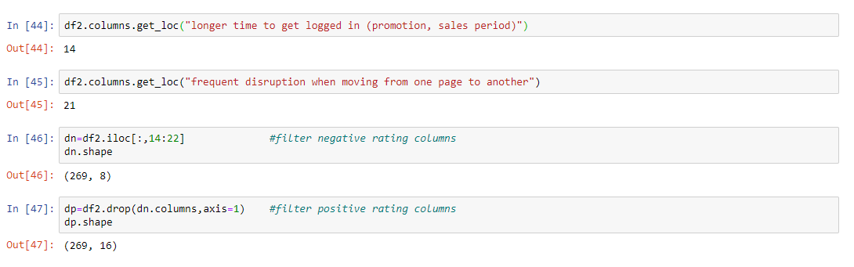
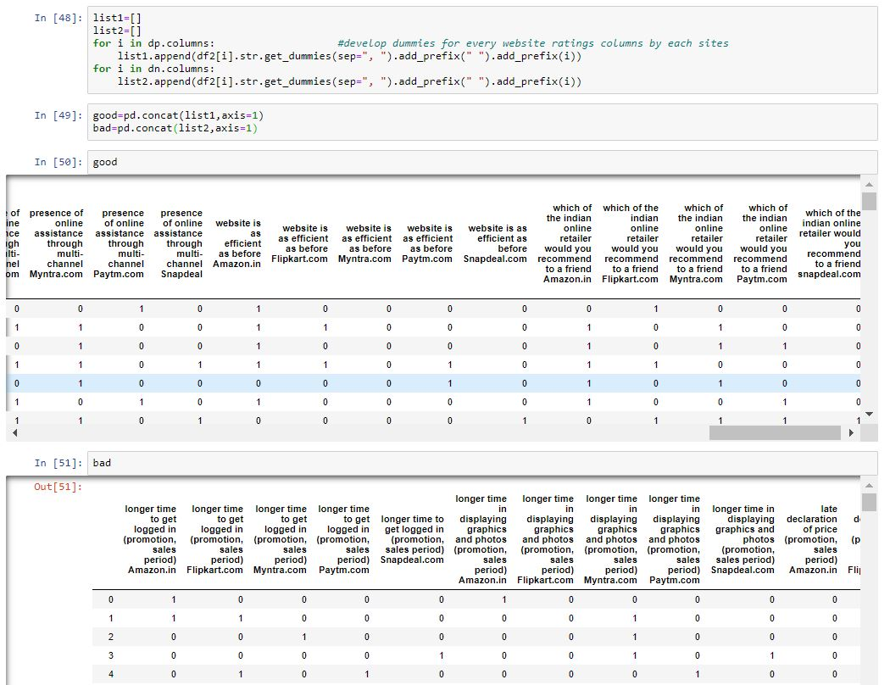
Visualize on web ratings:
There are some positive ratings and negative ratings columns, so we have to separate it for better visualization.
Encode the web ratings columns by develop dummies for every website ratings columns by each sites.

Slide 15
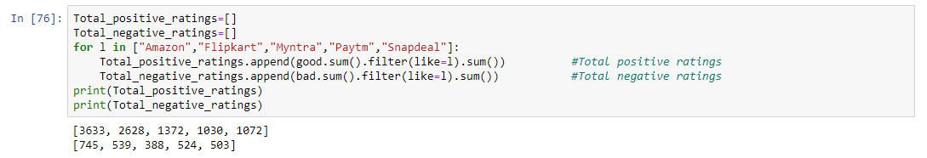
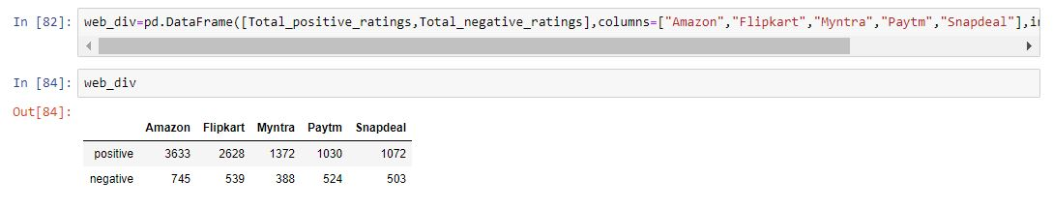
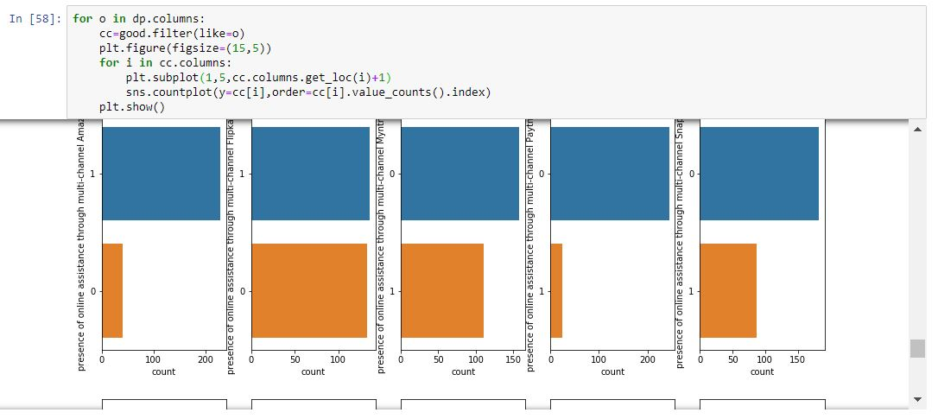
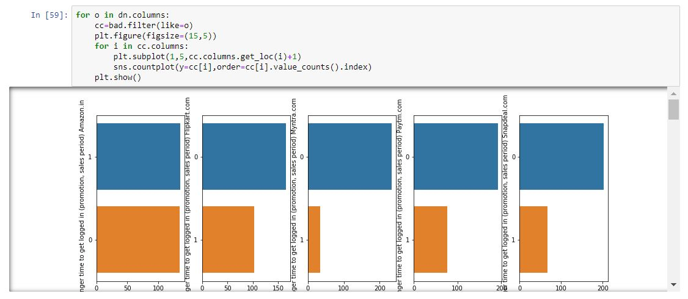
To find which website plays a major role for customers online shopping, after create dummies we have to sum each row as per website click by customer.
By analysis it came to know:
Amazon.in and flipkart.com are liked by most of the persons than different websites.

Slide 16
Findings:
For rating features mostly customer select strongly agree.
For customer details features(city-Delhi, browser-Google chrome, device-smartphone, net-Mobile Internet ) plays major role in online shopping.
For website rating features Amazon.in and flipkart.com are liked by most of the customers.

Slide 17
Conclusion:
It concluded that there is no wrong data, because all values are categorical obtain by click check boxes. By analyze it and prediction was lead to get good model.
Observed and analysis data through visualization.
As the end we get treated data frame with new findings by analysis of data given by Indian online retailer.

